Slide 1

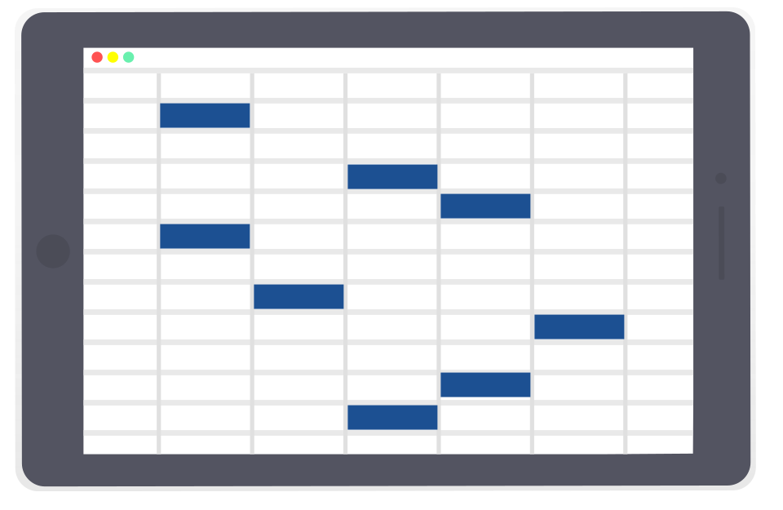
BEST PRACTICES FOR
WORK LIFE IN THE NEW NORMAL
The story of KPRIET’s past few months
Dr. M. AKILA M.E., Ph.D.,
PRINCIPAL,
KPR INSTITUTE OF ENGINEERING AND TECHNOLOGY, COIMBATORE.

Slide 2


Agenda
SERVICES
HELP IN DIRE TIMES
PRACTICES
FIGHTING COVID-19
ACHIEVEMENTS
OUR TEAM

Slide 3
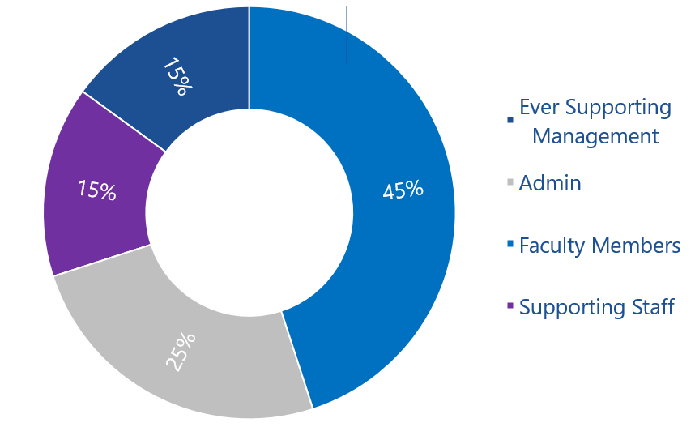
Meet Our Team
Working Round the Clock

Slide 4

Strength in Numbers
432 Employees in Total
45% women
56% teaching faculty
44% Non-Teaching
For the FAMILY
Online Counselling Session “Life Engineering Series” by Brahmachari Vignesh Chaitanya on May 17, 2020.
Online Fun Events, like Connections, Talk with a Film Star by the KPRIET Staff Club.
Teachers’ Day Celebrations.

Slide 5
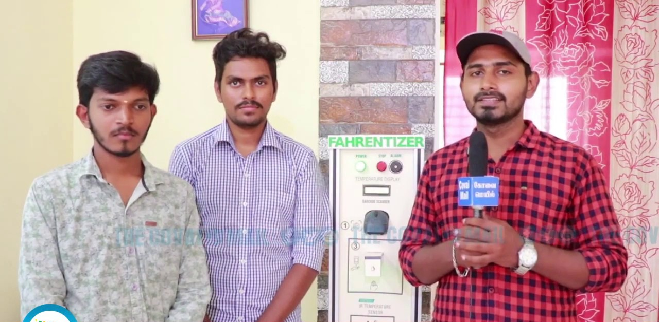
Thermal Scanning & Contact- Less Sanitizers
Made by the students,
For the Faculty and world

Slide 6
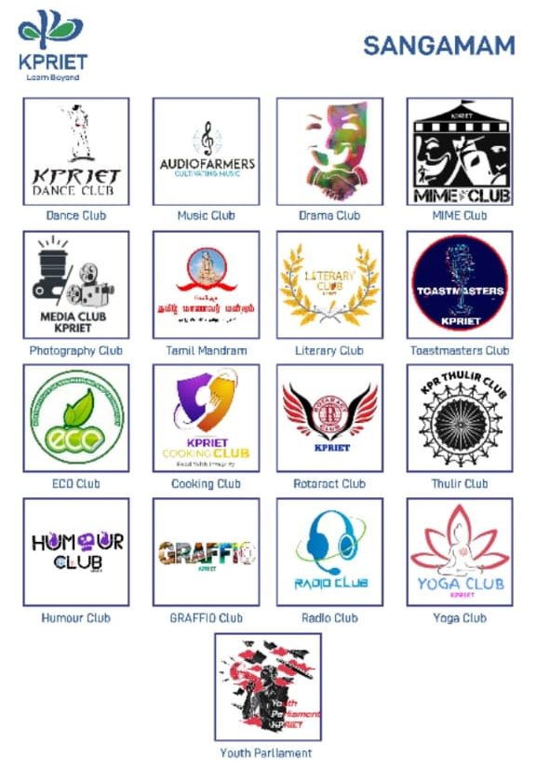





Online Events
For the Technical and Cultural events
Virtual SANGAMAM 2020
Virtual IGNITRRON 2020

Slide 7
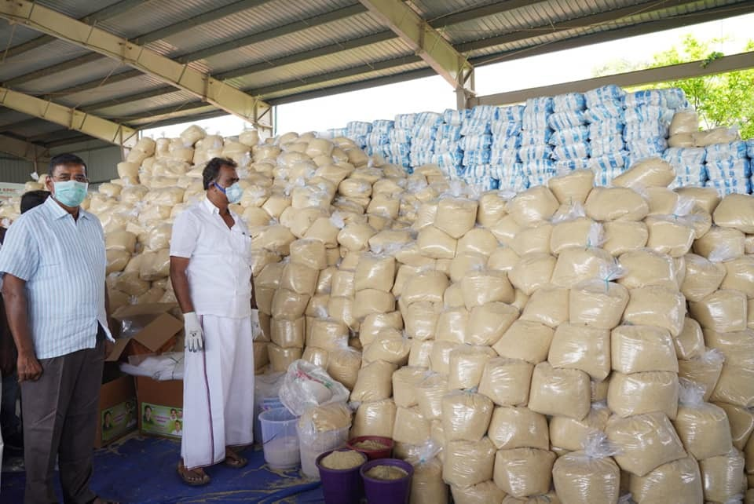
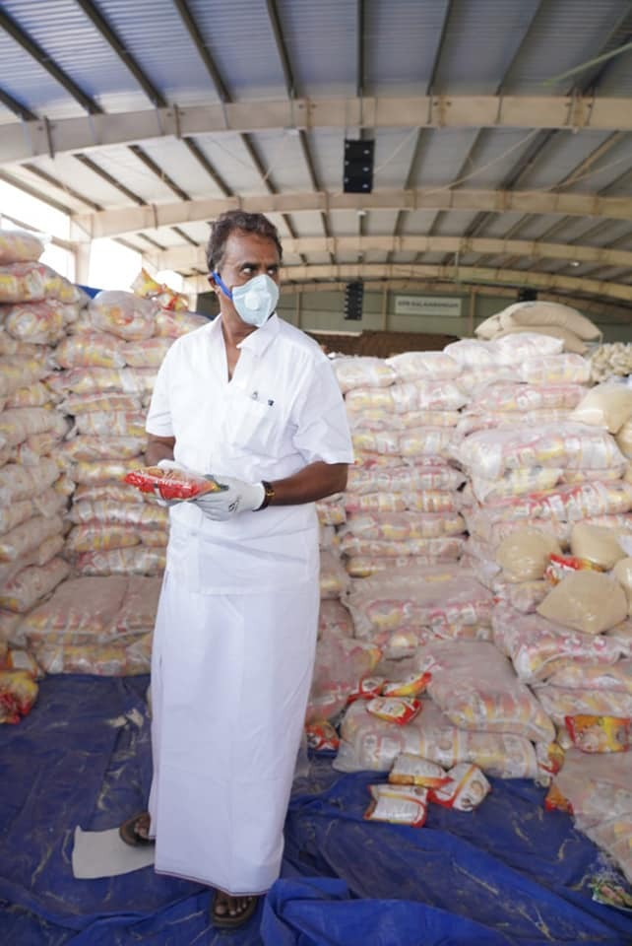
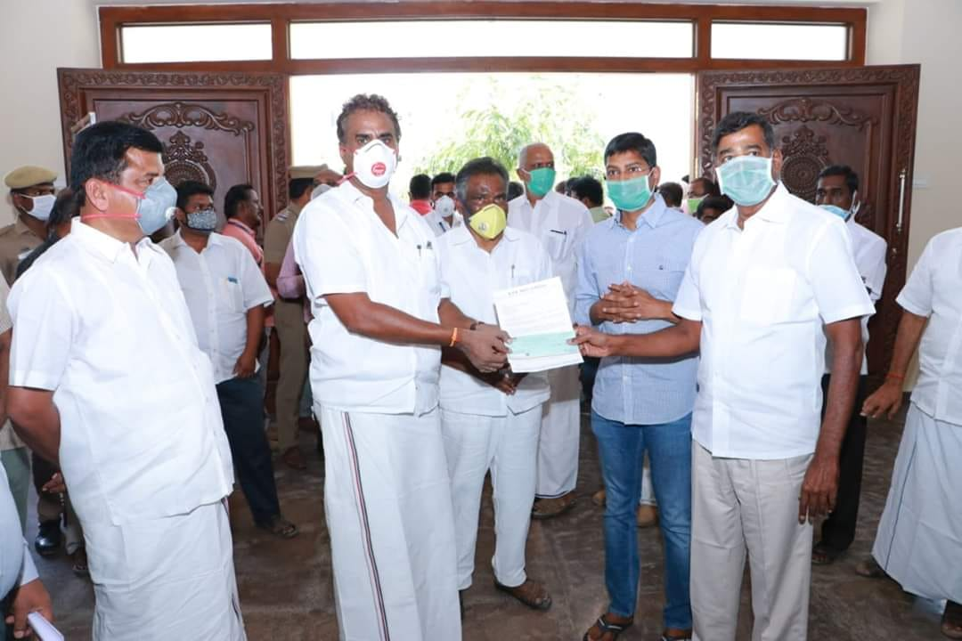
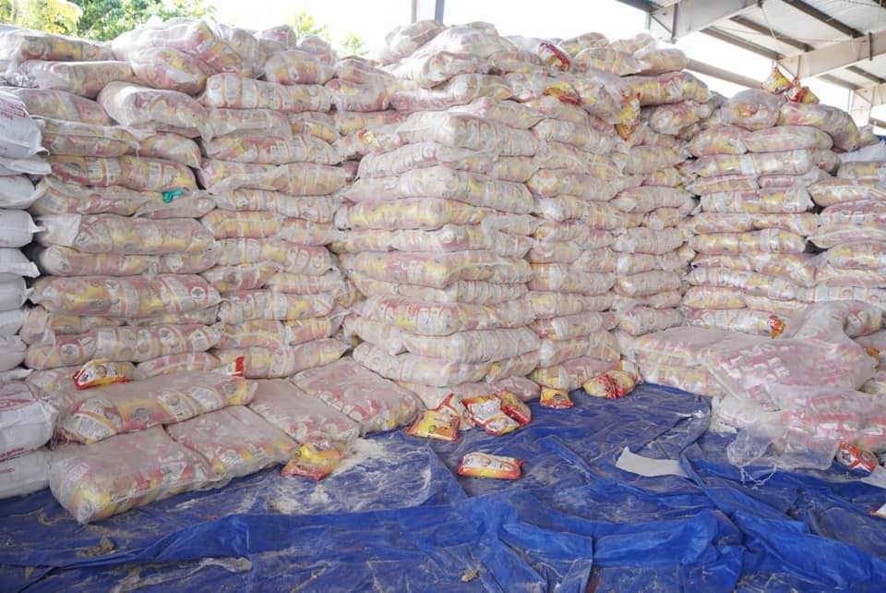
HELPING IN DIRE TIMES
1 Crore INR worth donation to Chief Minister’s Funds
Helping the needy by donating COVID Care Packages to about 3000 families
Distribution of Sanitizers and Face Masks to the community
Immunity Boosters for the employees

Slide 8
KPRIET’s Virtual Enhancement
Continuous Enhancement
Our IT Facility additions in the past few months
Online Classes, ICT Tools | Virtual Labs and recorded lectures | Product Development (SIG) – Area of Expertise
Google Classroom | V-labs | Journal Publications- 200
 |  | Online conferences – 80
Google Meet
 |  | Patents – 5
Jamboard | Moodle, Google Classroom | Proposals – 20
Piazza |  | Book chapters - 3

Slide 9
No Cost-cutting measures
Programmes to keep employee happy always
Fun Events
For all
Active Staff clubs
To stay engaged
Free accommodation for everyone
Active recruitment practices
Activities
Practices

Slide 10
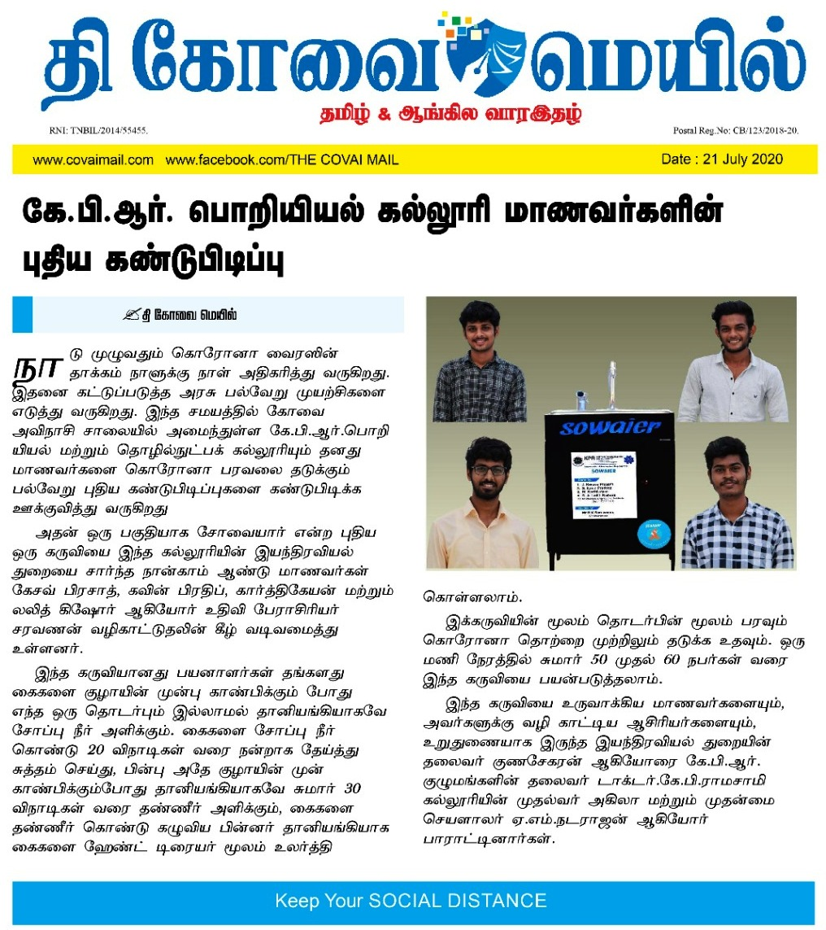
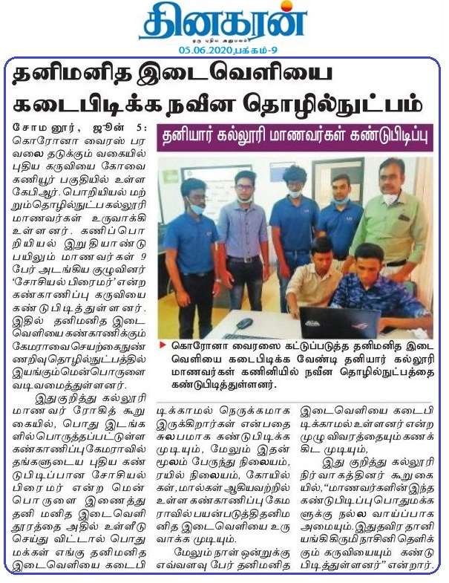

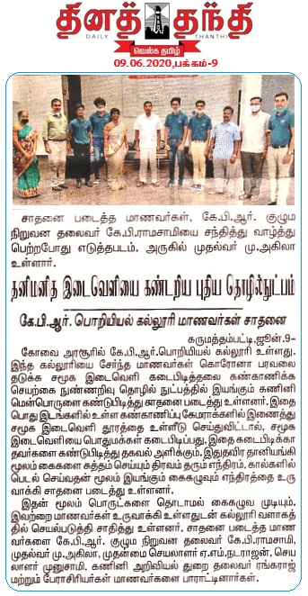
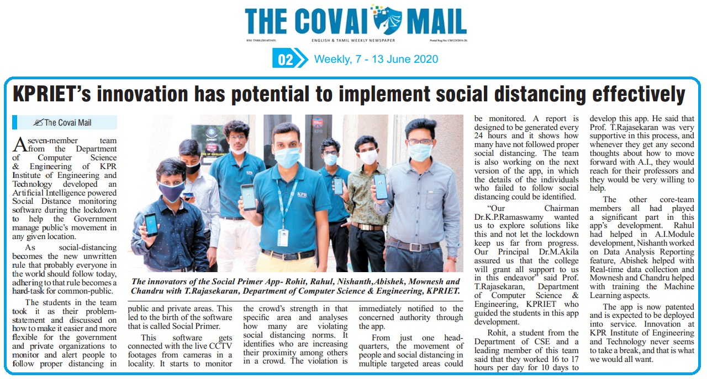
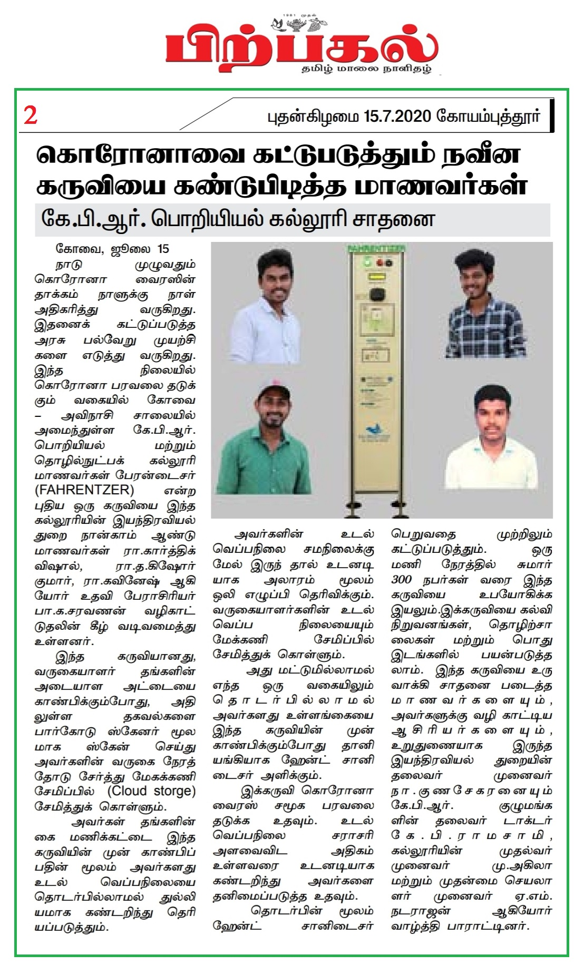
Fighting Covid-19
Achievements
Products Developed
Community outreach - Handing out Masks & Sanitizers
Rewarding employees for innovative minds
- 9 projects exclusively designed to combat Covid-19

Slide 11
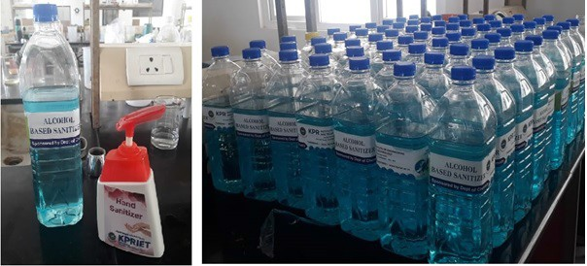
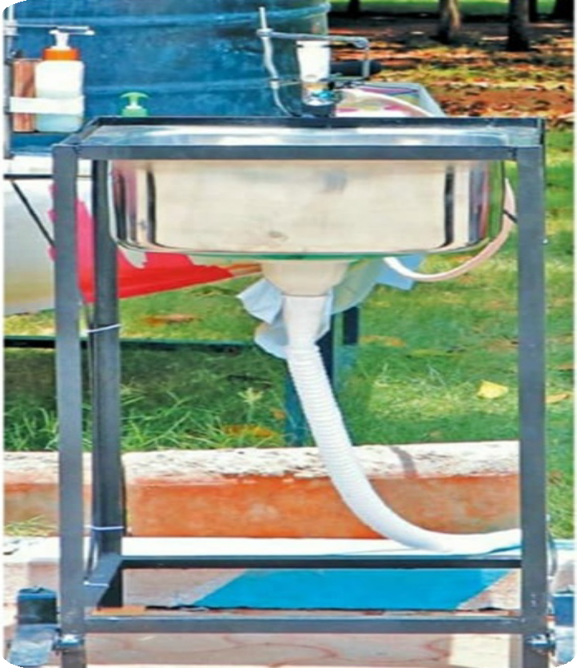
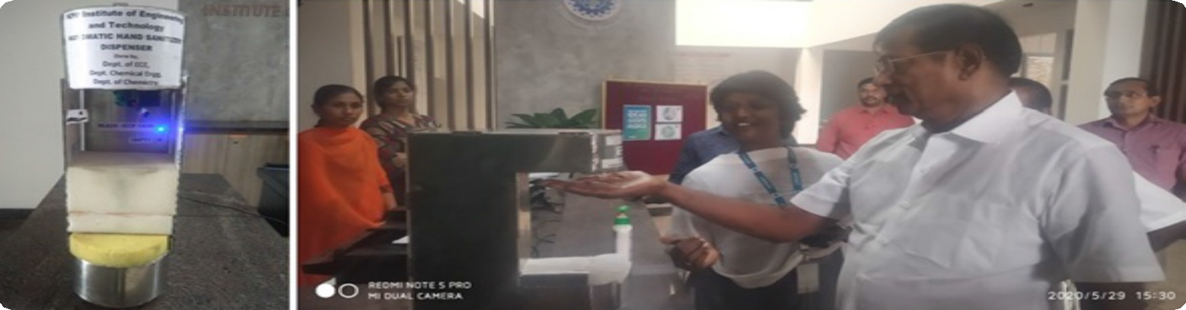
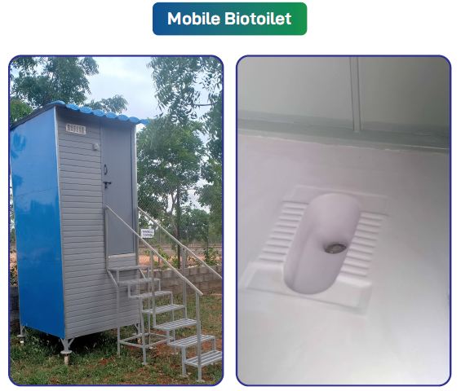
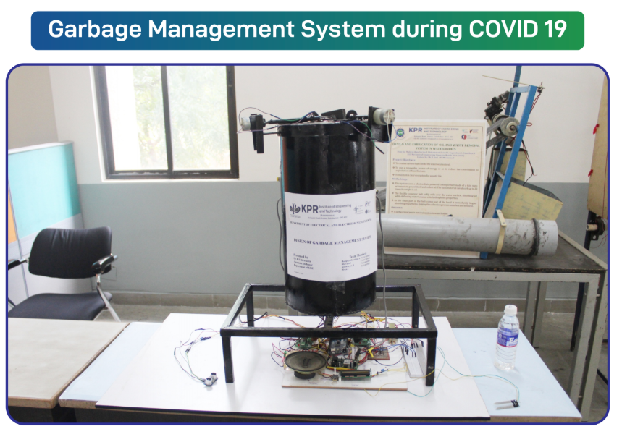
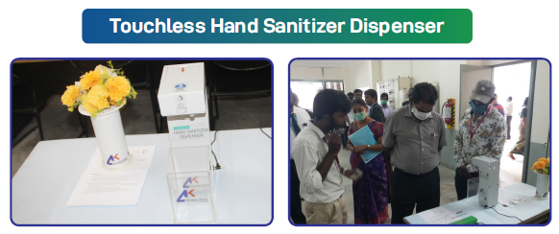
Achievements
Fighting Covid-19
Hand Sanitizers
Dr. K. P. Ramasamy, Chairman, KPRIET inspecting the automatic sanitizing machine designed by the students and faculty of the Dept. of ECE and Chemical Engineering.
No-Contact hand Wash

Slide 12


ACHIEVEMENTS
Facilities were created for
Uninterrupted coaching and continuous enhancement of knowledge.
Switching from unprepared state → Qualified within weeks.
Frictionless movement in Teaching - Learning Process.
Motivated Faculty
MOOCS-1550
Coursera, NPTEL (12000+ courses)
FDPs, Workshops (1000+)

Slide 13
Thank you

